Slide 1
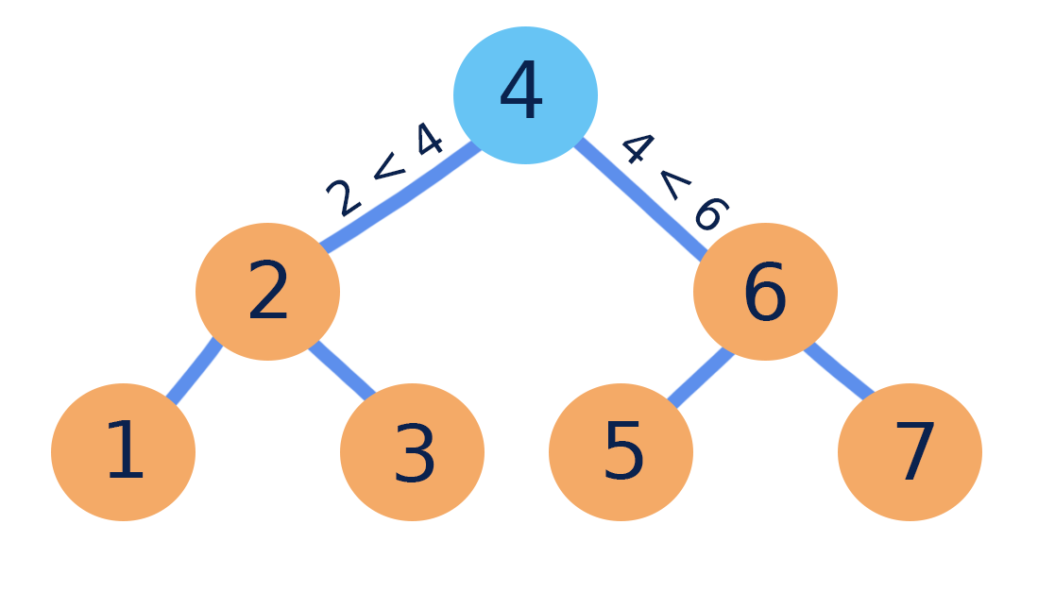
Binary Search Trees (BST)
The left subtree of a node contains only nodes with keys less than the node’s key.
The right subtree of a node contains only nodes with keys greater than the node’s key.
The left and right subtree each must also be a binary search tree.

Slide 2
Binary Search Trees (BST)
8
7
5
7
5
8
7
15
8
15
5
10
15
10
10
We can design BST in many different ways.

Slide 3
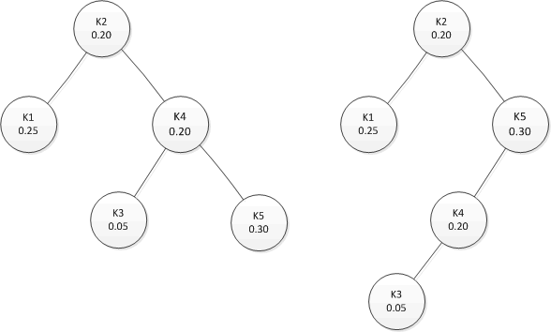
Binary Search Trees (BST)
Given sequence K = k₁ < k₂ <··· < k_{n} of n sorted keys
For each key k_{i} , we have a probability p_{i} that a search will be for k_{i}
In this example:
for k₁ < k₂ < k₃ < k₄ < k₅
assume we have: p₁₌ 0.25 , p₂₌ 0.20
p₃₌ 0.05 , p₄₌ 0.20
p₅₌ 0.30

Slide 4
Optimal Binary Search Trees
Problem Want to build a binary search tree (BST) with minimum expected search cost.
Actual cost = # of items compared.
For key k_{i}
cost = (depth_{T}(k_{i})+1). p_{i} where depth_{T}(k_{i}) = depth of k_{i} in BST
depth 0
depth 1
depth 2
depth 3

Slide 5
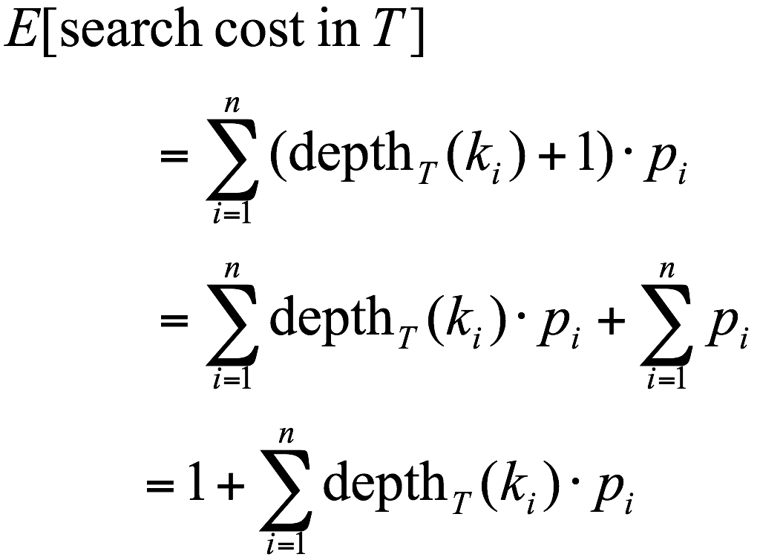
Expected Search Cost
Sum of probabilities is 1

Slide 6

Example
Consider 5 keys with these search probabilities: p₁ = 0.25, p₂ = 0.2, p₃ = 0.05, p₄ = 0.2, p₅ = 0.3
k₂
i depth_{T}(k_{i}) depth_{T}(k_{i})·p_{i}
1 1 0.25
2 0 0
3 2 0.1
4 1 0.2
5 2 0.6
1.15
k₁
k₄
k₃
k₅
Therefore, E[search cost] = 1+1.15=2.15

Slide 7
Example
What if the BST looks as below: p₁ = 0.25, p₂ = 0.2, p₃ = 0.05, p₄ = 0.2, p₅ = 0.3
k₂
k₁
k₅
i depth_{T}(k_{i}) depth_{T}(k_{i})·p_{i}
1 1 0.25
2 0 0
3 3 0.15
4 2 0.4
5 1 0.3
1.10
k₄
k₃
Therefore, E[search cost] = 2.10
This tree turns out to be optimal for this set of keys.

Slide 8
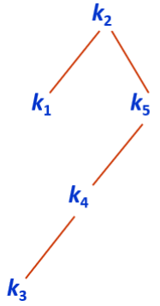
Example
Observations:
Optimal BST may not have smallest height.
Optimal BST may not have highest-probability key at root.
Naïve Approach to build the optimal BST?
Construct each n-node BST.
For each one, assign keys and compute expected search cost.
The number of possible BSTs are exponential.

Slide 9
Dynamic Programming Approach
Suppose that key_{i} to key_{j} should be arranged so that is minimized!
c_{m} is the number of comparisons to locate key_{m}
Suppose that we store such result in M[i][j]
In that case M[i][i] = p_{i}

Slide 10
Principle of Optimality
To obtain the optimal search tree, any sub-trees should be optimal.
Therefore, the principle of optimality holds.

Slide 11
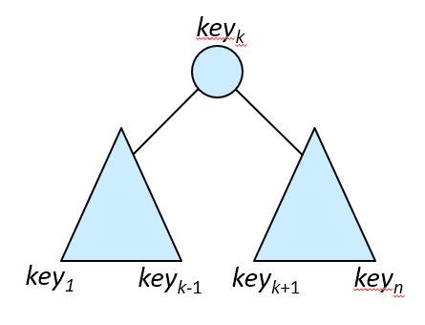
Dynamic Programming Approach
Assume that we consider key_{k} as the root
Left subtree of key₁ to key_{k−1}
Right subtree of key_{k+1} to key_{n}
Then, for the total cost we have:
M[1][k-1]+p₁+p₂+…+p_{k-1}+p_{k}+M[k+1][n]+p_{k+1}+…+p_{n}
When choosing a root, every node in the subtree moves one level deeper.
The additional cost for each node is equal to its probability multiplied by the extra depth.
The term p₁+p₂+…+p_{n}​ represents this increase in cost across all nodes.

Slide 12
Dynamic Programming Approach
For the total cost we have:
M[1][k-1]+p₁+p₂+…+p_{k-1}+p_{k}+M[k+1][n]+p_{k+1}+…+p_{n}
Since one of the k trees can be optimal, we have:
M[1][n]= (M[1][k-1]+M[k+1][n]) +

Slide 13
Dynamic Programming Approach
In general, from key_{i} to key_{j} , where i<j
M[i][j] = (M[i][k-1]+M[k+1][j]) +
M[i][i] = p_{i}
M[i][i-1] and M[j+1][j] are defined 0
To find an optimal BST:
Examine all candidate roots key_{k} , for i ≤ k ≤ j
Determine all optimal BSTs containing key_{i},...,key_{k-1} and containing key_{k+1},...,key_{j}

Slide 14
Algorithm for Optimal Binary Search Tree
void OptBST(int n, float p[], index R[][]){
int i, j, diagonal;
float M[1..n+1][0..n];
for(i=1; i ≤ n; i++){
M[i][i]=p[i]; M[i][i-1]=0;
R[i][i]=i; R[i][i-1]=0;
}
M[n+1][n]=0; R[n+1][n]=0;
for(diagonal=1; diagonal≤n-1; diagonal++)
for(i=1; i≤ n-diagonal; i++){
j= i + diagonal;
M[i][j] = (M[i][k-1]+M[k+1][j]) +
R[i][j] = a value of k that gave the minimum; }
print (“result=“, M[1][n]); }
Complexity is O(n³)

